Slide 1

Leave Request Application
BOOTCAMP UKSW x ADD BATCH 2
PT. METRODATA

Slide 2
Why we need it?
Leave Request Application
Melakukan permintaan cuti karyawan kepada manager
Pengajuan cuti mudah dan ringkas
Laporan data yang jelas terhadap karyawan dan manager

Slide 3
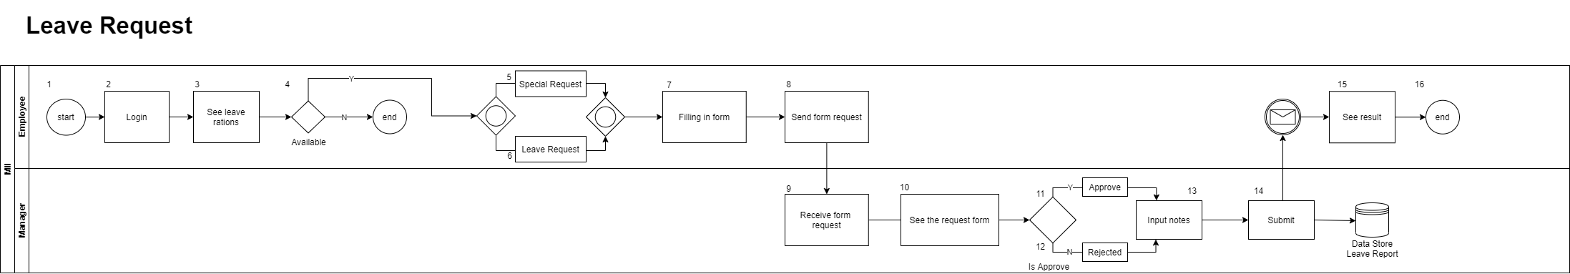
Business Process

Slide 4
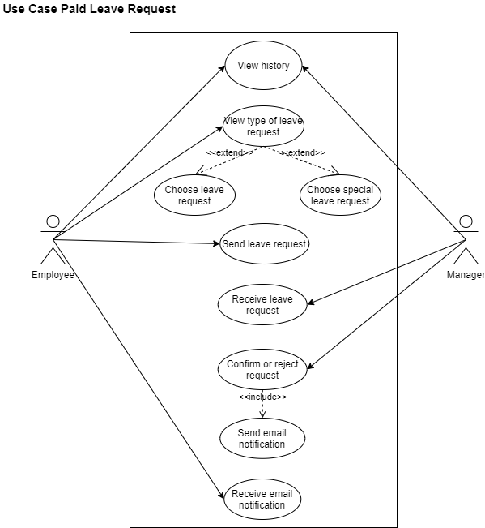
Use Case

Slide 5
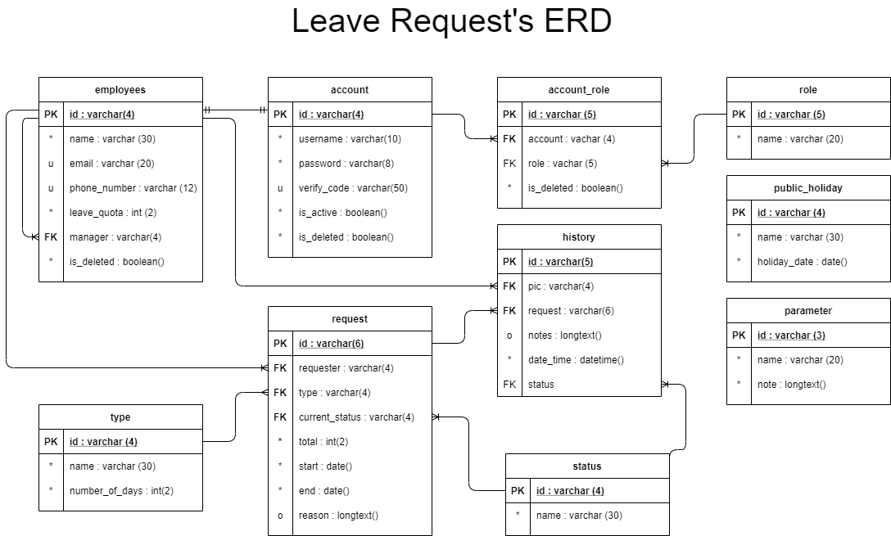
Entity Relational Diagram (ERD)

Slide 6
Laptop mockup
Sea vidit feugiat blandit no. Ne illud vituperata reformidans cum, ut his solum malis definitionem. No qui graece diceret delicata, idque numquam mea ex. Hinc conceptam adolescens quo no, clita feugait te sed. An unum partem vulputate eam, eu unum augue viderer sit, sea cu impetus integre.

Slide 7
Responsive design
Eam sint posidonium ut, esse integre usu ne, eius praesent duo eu. Vivendo singulis incorrupte vix at, mea diceret inciderint id. Expetendis posidonium constituam nec et. Graeci mediocrem evertitur eos te.

Slide 8
Thank you for watching!
Any questions?
The Power of PowerPoint – thepopp.com
Title Font: Cooper Hewitt Roman (TTF version)
Body Font: Gidole

